Slide 1
IVA
Interactive Visual Aid

Slide 2
Abstract
IVA is a Progressive Web Application (PWA).
It Can be installed as an application.
It Can be accessed with network and without network.
It serves Web pages with PDFs, Videos, Images and Presentations.
We need to download the PDFs, Videos Or Presentations to get offline access.
Offline Access is implemented using cache and Index DB API.

Slide 3
Introduction
Motivation for the work
To provide offline access of the web application for clients, Whenever they are not having proper network connection.
Real World Applications
Users who are not having proper network connection can access this application.

Slide 4
Related Works/Existing Works
Few Related Works and Their limitations:
Where is my train app is an application which provide offline functionality But Its purpose is different from ours.

Slide 5
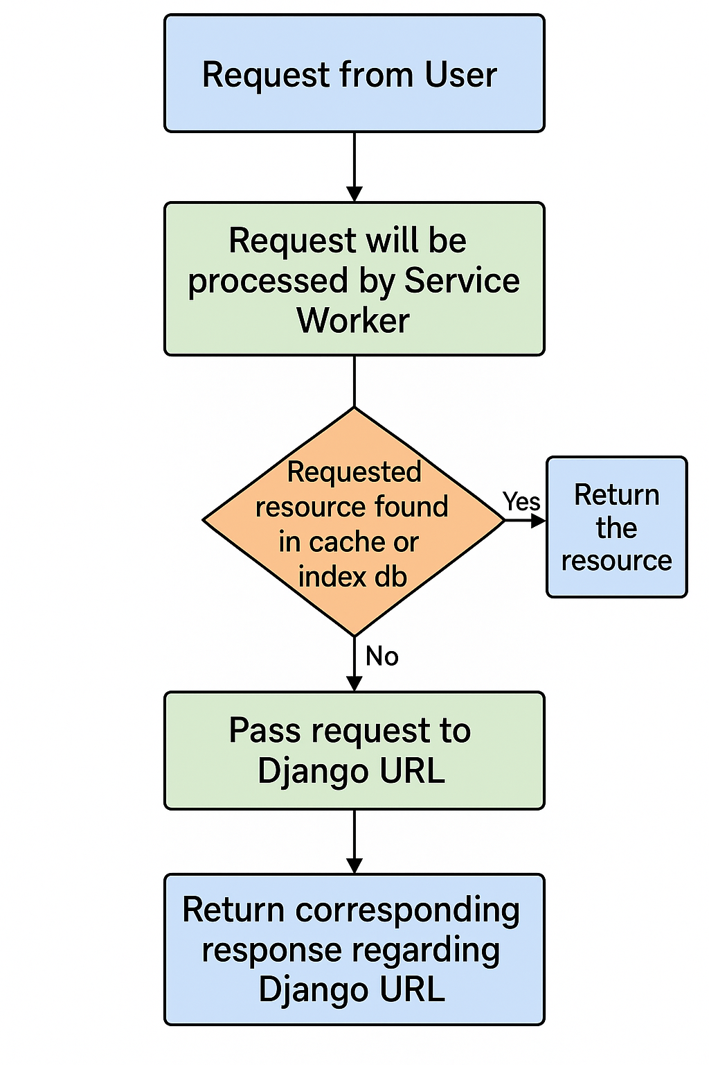
Proposed Method
Flowchart of proposed approach.

Slide 6
Experimental Results
Technologies/libraries used
Django
Java Script
PostgreSQL

Slide 7
Conclusions
This IVA provides offline access to essential assets, bridging connectivity gaps and ensuring a seamless user experience.

Slide 8
Future Scope/Directions
Currently we are just serving web pages with images, PDFs, Videos and presentations. We are in a plan to develop feature like taking input(text, files etc.,) from user and store it in database.
Currently we are storing which user accessed which content in database only when user access the application using network, We would like to make that happen in offline too.

